Slide 1
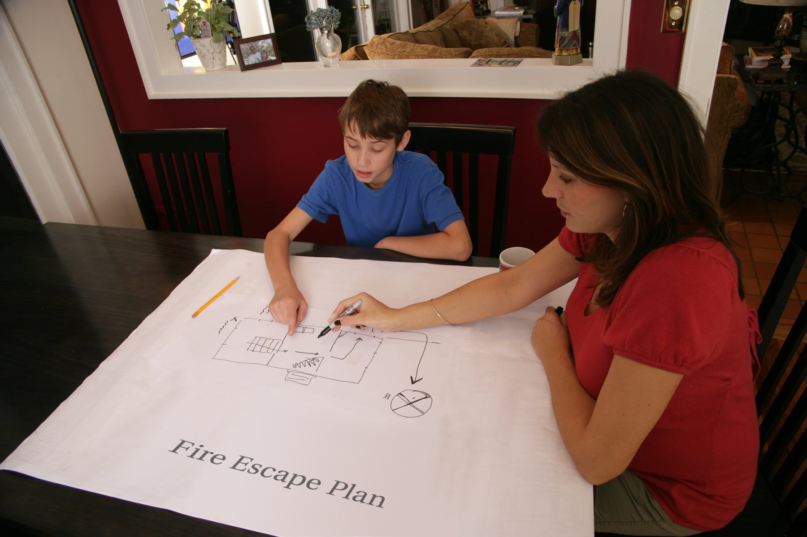
Home Escape Planning
Learn to stay safe from fire at home

Slide 2
In this lesson, you’ll learn:
What to do in a fire.
To make a home escape plan.
To check the smoke alarms in your home.
To have a home fire drill.
What to do if your home fills with smoke.
Let’s start with a story.

Slide 3
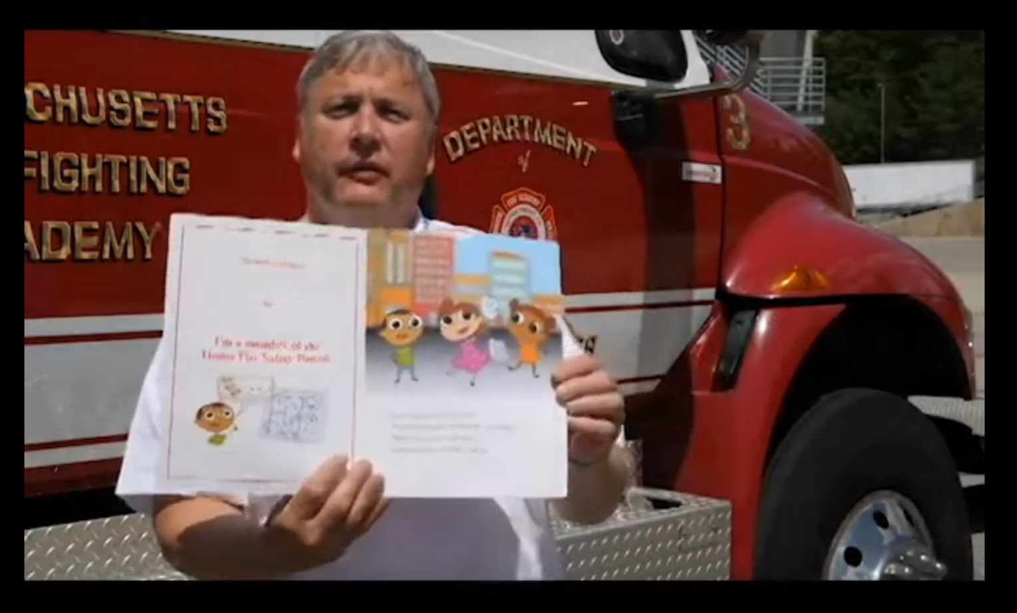
Listen to State Fire Marshal Peter Ostroskey read a story about home fire safety.
Click here for the story.
Click here to follow along.

Slide 4
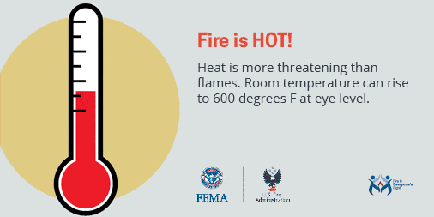
What do you know about fire?
Is fire hot?
Yes! Fire is very, very hot.

Slide 5
Can you see during a fire?
No!
Fire makes thick, black smoke you can’t see through.

Slide 6
Does fire move slowly?
No!
Fire moves very, very fast.

Slide 7
Now you know:
Fire is hot.
Fire is fast.
Fire is dark.
You must act fast in a fire.
You have only 1 – 3 minutes to escape.

Slide 8
Name something in your house that tells you if there is a fire.
Did you say. . .
SMOKE ALARMS ?
Correct!
Smoke alarms warn you about danger.

Slide 9
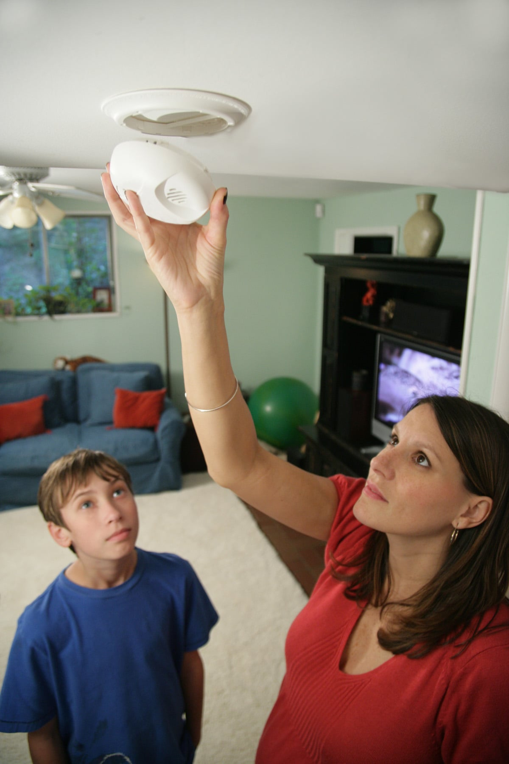
Ask an adult in your house to
check the smoke alarms.
Smoke alarms must be less than 10 years old.
Most smoke alarms need new batteries twice a year.
Test your alarms. Press the button. Hear the loud alarm.

Slide 10
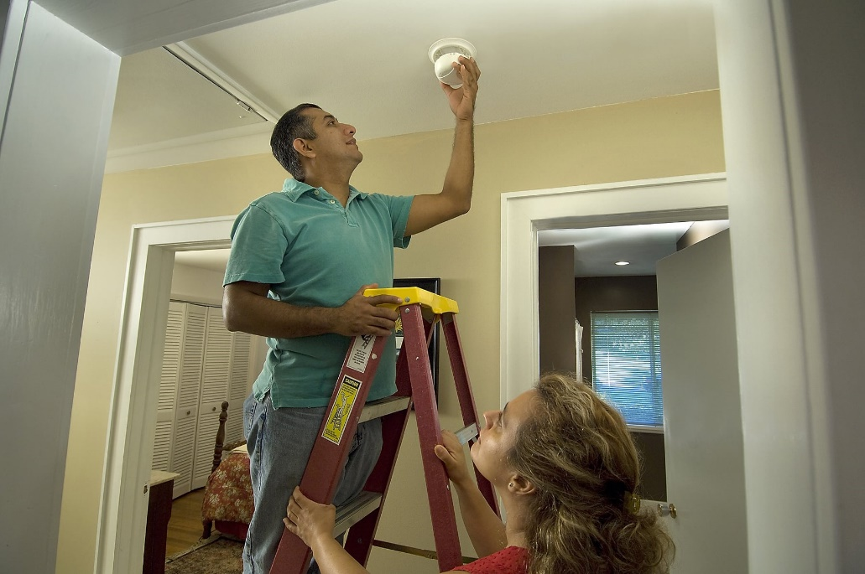
Remember, fire is hot, fast and dark.
Correct!
Make sure your smoke alarms are working
so you can act fast if a fire starts.

Slide 11
What else can keep you safe from fire?
A Home Escape Plan!
Making a home escape plan,
and practicing it, helps everyone in your
family to escape when a smoke alarm sounds.

Slide 12
Make Your Home Escape Plan
Step 1
Together with your family,
look at each room in your house.
Find at least 2 ways out of every room.

Slide 13
The best way out is . . .
Doors

Slide 14
Other ways out:
Doors
Windows
Doors

Slide 15
Other ways out:
Fire Escapes

Slide 16
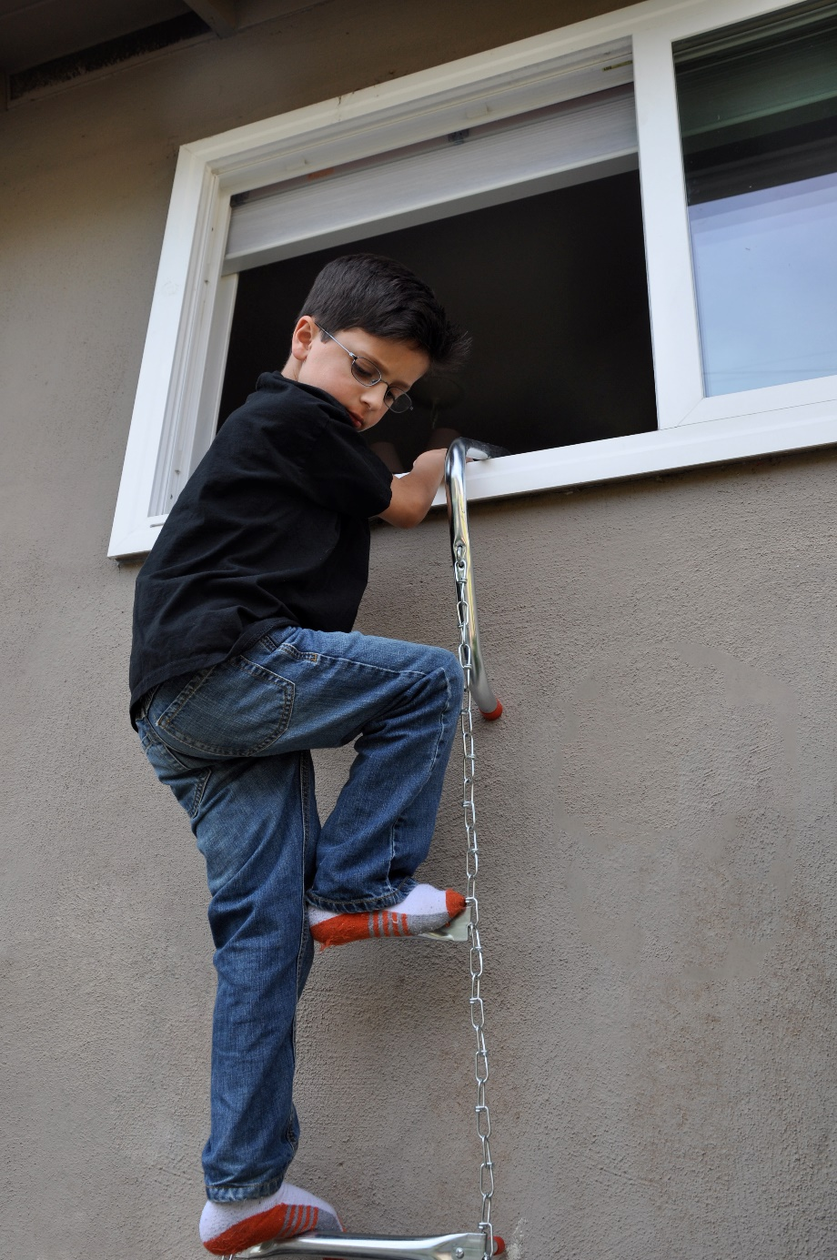
Other ways out:
Ladder to put over a window sill
There are many ways to get out!

Slide 17
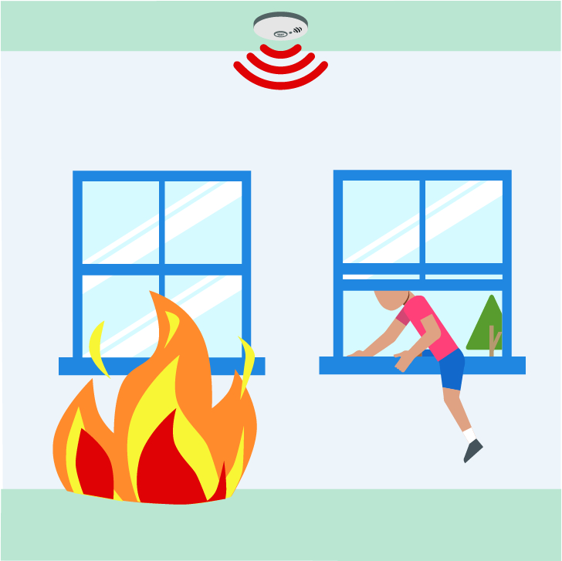
Why do you need
2 ways out
of every room?
Because fire or smoke can block one of
the exits!

Slide 18
Make Your Home Escape Plan
Step 2
1. Get your family
2. Get a large piece of paper and pens or markers.
3. Ready?

Slide 19
Draw a floor plan of your home, like this:
Label the rooms.
Dining Room
Kitchen
Bath
Bedroom
Include all doors and windows.
Draw the smoke
alarms.
Living Room
Bedroom
Bedroom

Slide 20
Start here
Draw arrows showing two ways out of each room.
Dining Room
Kitchen
Bath
Bedroom
Bedroom
Bedroom
Living Room

Slide 21
Does everyone in your family know
2 ways out of each room in your home?
Practice until everyone knows!

Slide 22
Add a safe, outdoor meeting place for the family.
It should be:
Away from the home.
Where firefighters can see you.
Dining Room
Kitchen
Bath
Bedroom
Living Room
Bedroom
Bedroom
Meeting Place

Slide 23
Where will your meeting place be?
A tree ?
A mailbox?
A rock ?
A lamppost ?
A neighbor’s house?

Slide 24
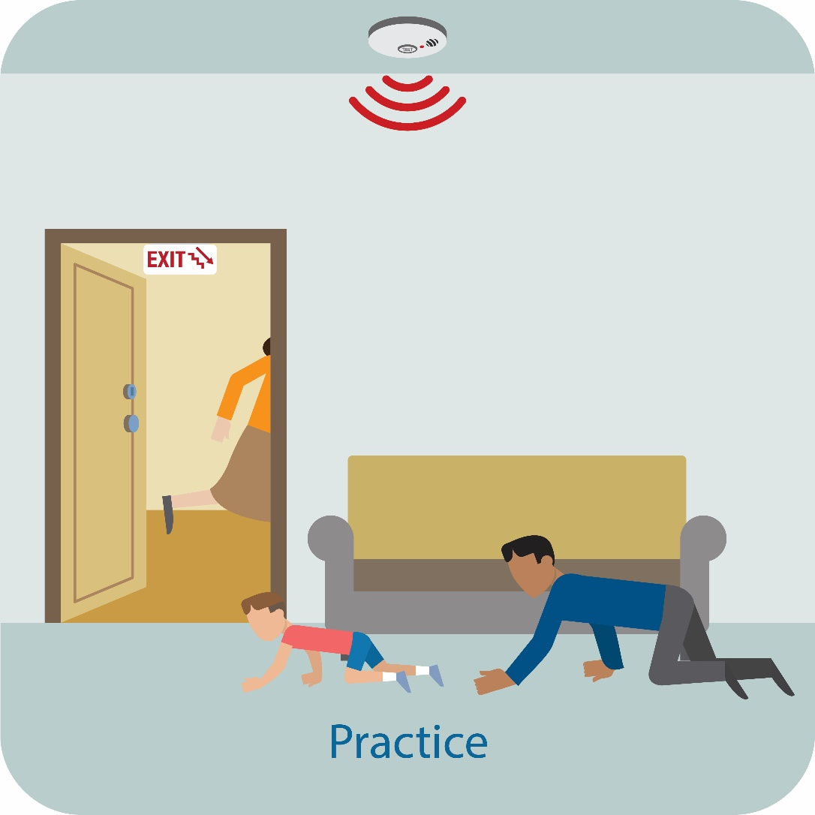
Make Your Home Escape Plan
Step 3
Practice your plan.
Have a fire drill
for the whole family.

Slide 25
Safety Challenge #1
If there is a fire,
you have 1 to 3 minutes to escape.
Challenge everyone to get out
of the house in 2 minutes or less.
Practice with a timer until everyone can get out fast.

Slide 26
Safety Challenge #2
Practice escaping at night, when it’s dark.
Everyone has to get out
in 2 minutes or less.
Practice with a timer until everyone can get out fast.

Slide 27
Safety Challenge #3
Take a picture of your family
at your meeting place.
Send the picture to the
fire department.
They can post it
on social media.
Use the hashtag: #practicetheplan
hashtag not consistent with the hashtag in the AHH #makesomenoise……

Slide 28
In a fire, remember . . .

Slide 29
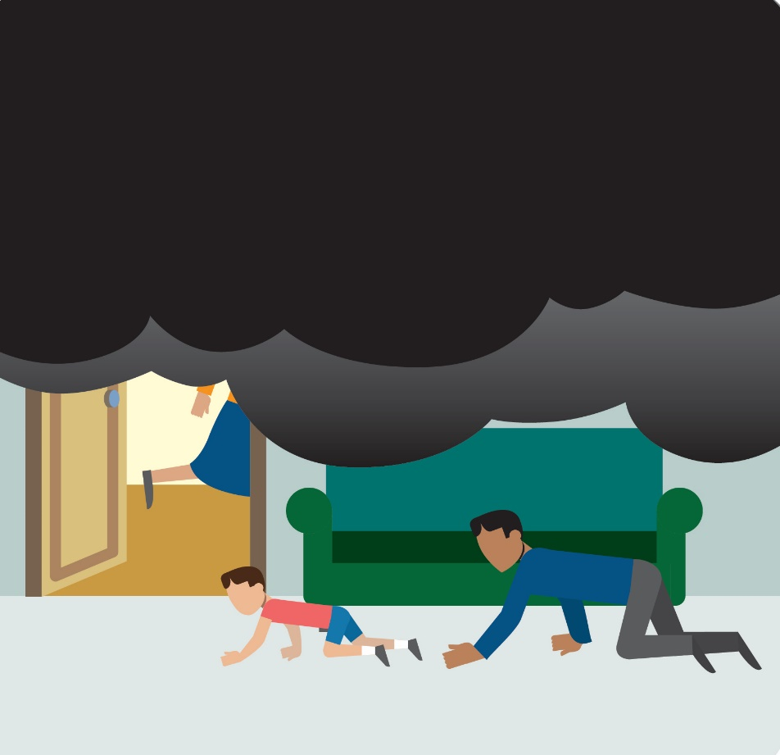
If it’s smoky, get low and go.
Good air is near the ground.
Close doors on the way
out of each room.

Slide 30
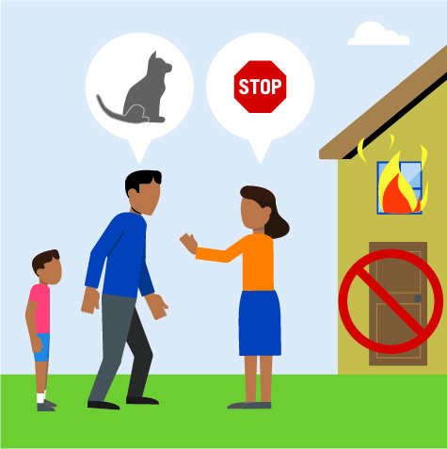
Don’t go back inside
for anything!
Not even pets.
Firefighters will
do that.

Slide 31
Call 911 . . .
From your
meeting place.

Slide 32
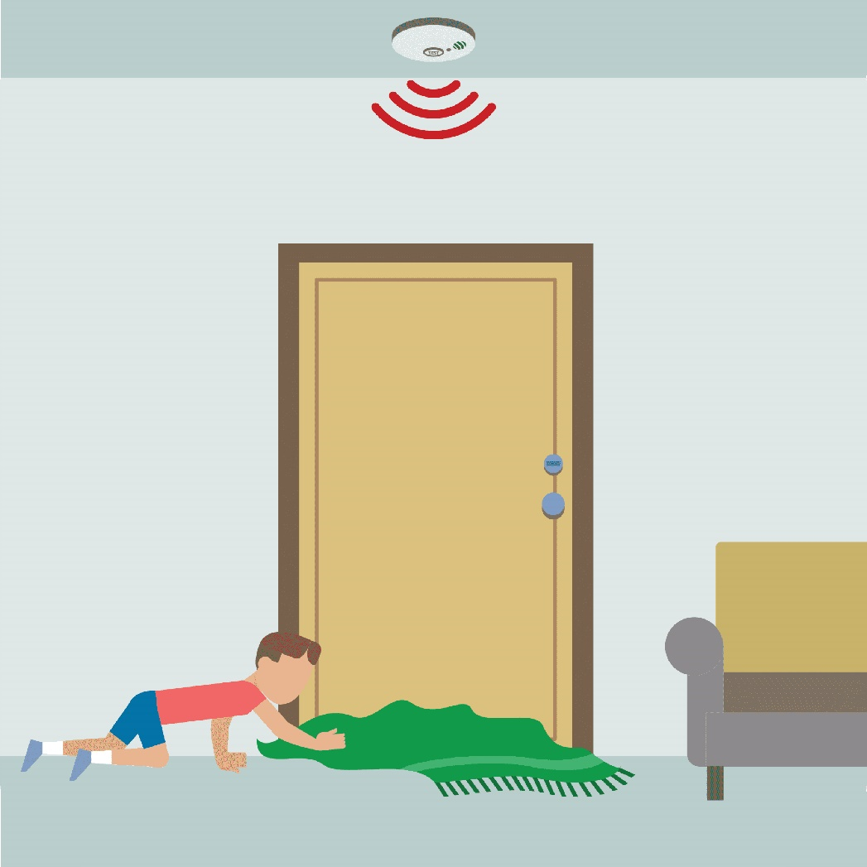
If both your exits are blocked in a fire . . .
Stuff clothes or blankets
under the door to keep
the smoke out.
And . . .

Slide 33
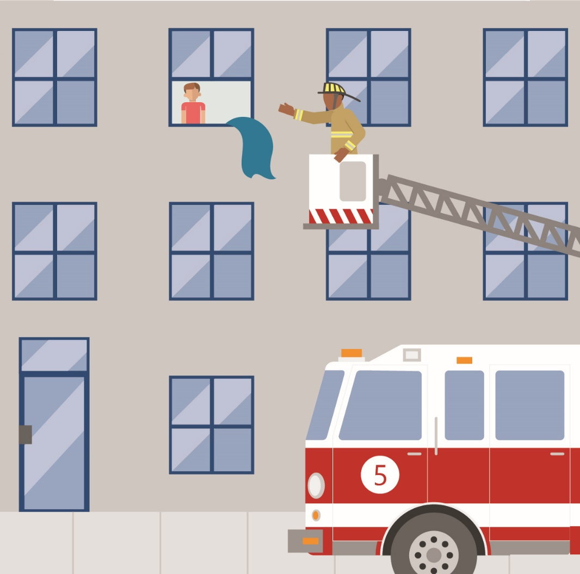
If you are trapped in a room in a fire:
Open the window.
Hang a blanket or sheet out the window.
Call out your location.
Shine a flashlight out to show where you are.

Slide 34
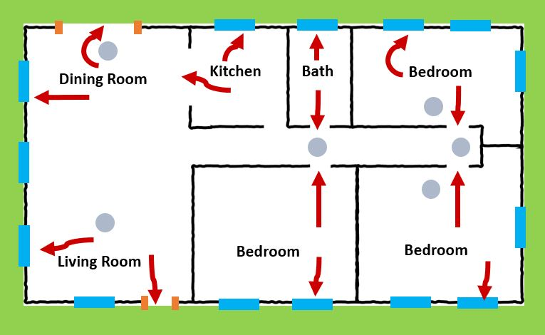
Great Work !
You made a home escape plan.

Slide 35
Together with your family, you:
Checked your smoke alarms.
Learned 2 ways out of every room in your house.
Practiced your home escape plan.

Slide 36
Congratulations !!!
You know how to escape a fire.

Slide 37
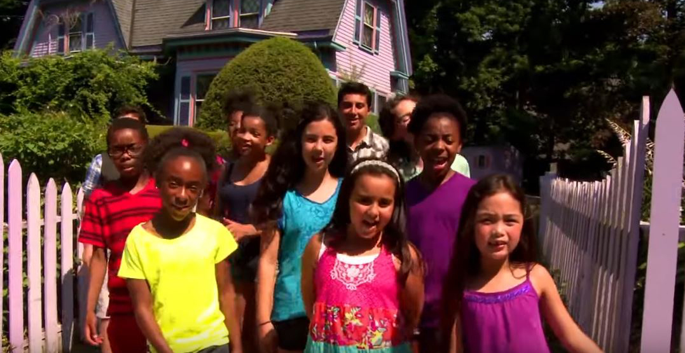
Watch this video about fire safety.
And visit Sparky.org for more fun activities.

Slide 38
Brought to you by the
Massachusetts Department of Fire Services
Division of Fire Safety
For more fire safety information, visit
www.mass.gov/fire-safety-for-the-public
Photo and Video Credits
Shutterstock Images
U.S. Fire Administration, www.usfa.fema.gov
National Fire Protection Association, www.nfpa.org
Young Minds Inspired or Home Fire Safety Patrol, https://ymiclassroom.com/
Gina Cali, Fire Prevention Division, Santa Clara County Fire Department

