Slide 1
Direct Claims Self Service (DCSS) Commercial
COVID-19 OTC Test Kit MEMBER GUIDE

Slide 2
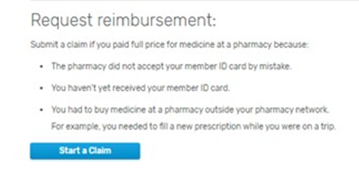
Current Direct Claims Process
Introduction
Members can submit a claim form for prescriptions purchased without their member ID card.
Currently, members can obtain a claim form by:
Calling Member Services and having it mailed to them
Logging in to express-scripts.com and printing a copy or requesting a mailed copy
They complete the form and mail it to us for processing.
The claim form is now available for completion and submission electronically, facilitating the process for members and Express Scripts.

Slide 3
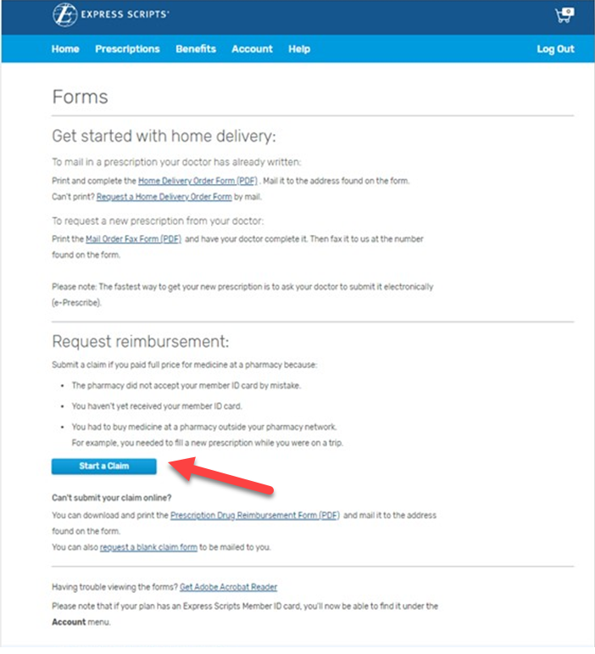
Electronic Direct Claim Process
A member can submit an electronic direct claim on the Forms page via
Submit a Claim Online button

Slide 4
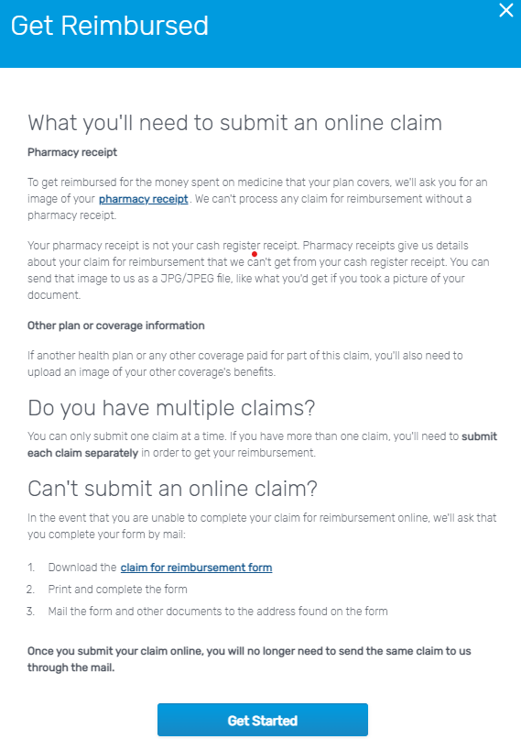
Informational Claim Page
Requirements
Members can submit an electronic direct claim if:
It is a single-ingredient drug
COVID-19 OTC Test Kits should be submitted under single-ingredient drug
It is a compound drug
It was purchased in the U.S. or is foreign-bought medicine
It is allergy serum
Coordination of benefits (COB)
They are registered on express-scripts.com

Slide 5
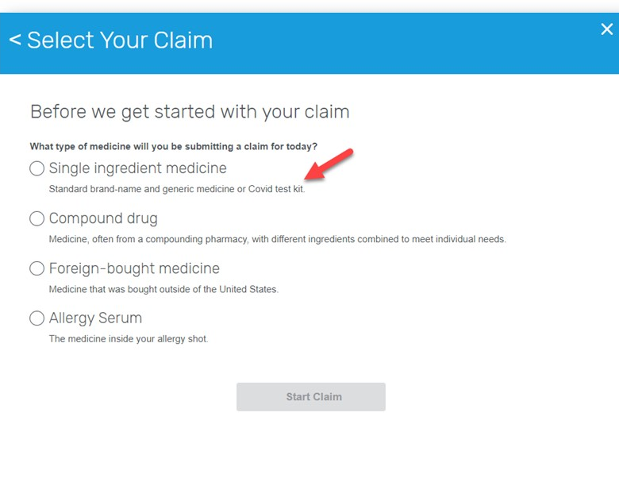
Starting a Direct Claim – Select Your Claim
Select claim type:
Single-ingredient medicine
Compound drug
Foreign-bought medicine
Allergy Serum

Slide 6
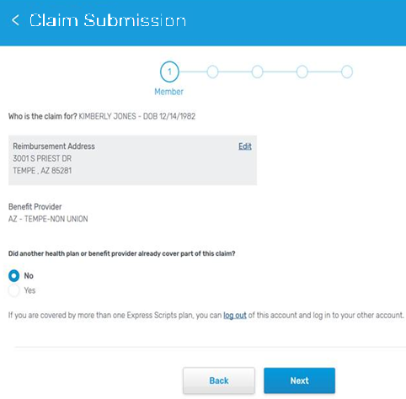
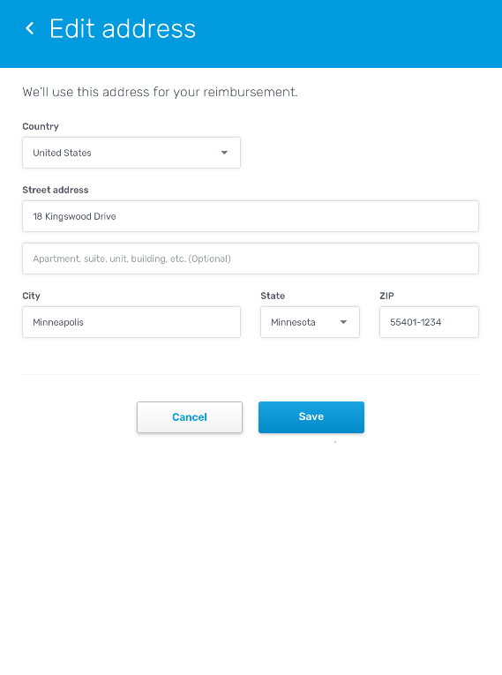
Starting a Direct Claim
Getting Started (regular claim)
Member’s eligibility address is the default address.
The address can be changed but will only be used for reimbursement.
The member can’t submit the claim under any other benefit except the one they are logged in under.

Slide 7
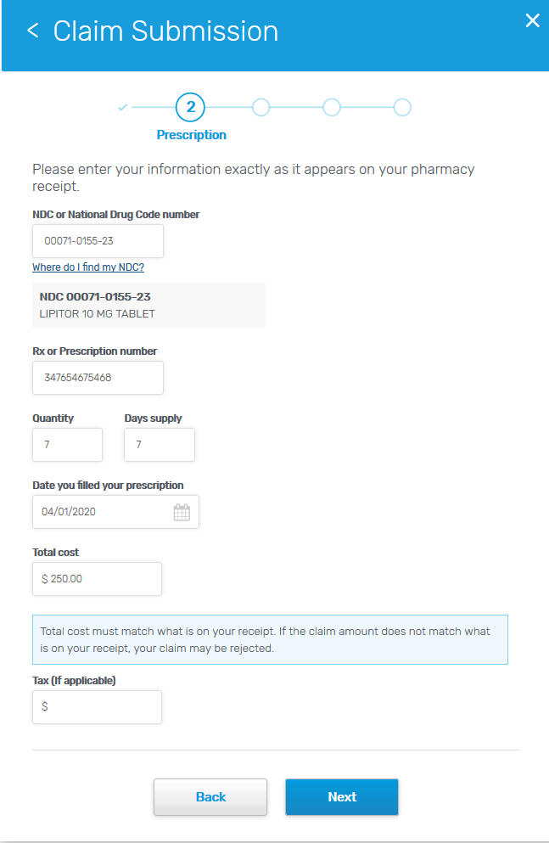
Prescription Information
Completing each step – COVID-19 OTC Test Kit
Pharmacy receipts are the recommended receipt which includes detailed information about your prescription and payment (provided at pharmacy counter, after submission through benefit)
If pharmacy receipt is not provided, a standard cashier receipt with COVID-19 OTC Test Kit UPC can be used
NDC – please see next slide for NDCs associated with approved COVID-19 OTC Test Kits
Rx or Prescription number – member may enter a default Rx number ‘1234567’
Quantity = 1 ; Days Supply = 30
Date – purchase date of COVID-19 OTC Test Kits
Cost – include cost of kits as shown on receipt

Slide 8
Approved COVID-19 OTC Test Kit NDC
Find the name of your purchased COVID-19 OTC Test Kits from the list. Input the associated NDC into Step 2 of the online submission form.
Test Kit Name | Manufacturer | NDC | # Test per Kit
BD Veritor At-Home COVID-19 Test | Becton Dickinson | 08290256088 | 1
BinaxNOW COVID-19 Ag Card Home Test | Abbott | 11877001140 | 2
Ellume COVID-19 Home Test | Ellume | 56964000000 | 1
Flowflex COVID-19 Antigen Home Test | ACON | 82607066026 | 1
Flowflex COVID-19 Antigen Home Test | ACON | 82607066027 | 2
Flowflex COVID-19 Antigen Home Test | ACON | 82607066028 | 5
iHealth COVID-19 Antigen Rapid Test | iHealth Labs | 56362000589 | 2
iHealth COVID-19 Antigen Rapid Test | iHealth Labs | 56362000590 | 5
InteliSwab COVID-19 Rapid Test | OraSure | 08337000158 | 2
QuickVue At-Home COVID-19 Test | Quidel | 14613033972 | 2
QuickVue At-Home COVID-19 Test | Quidel | 14613033968 | 5

Slide 9
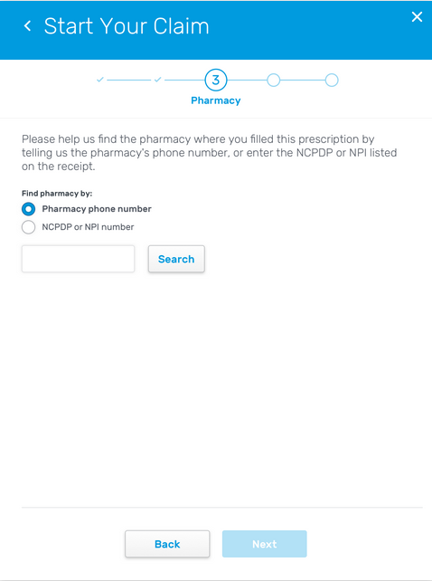
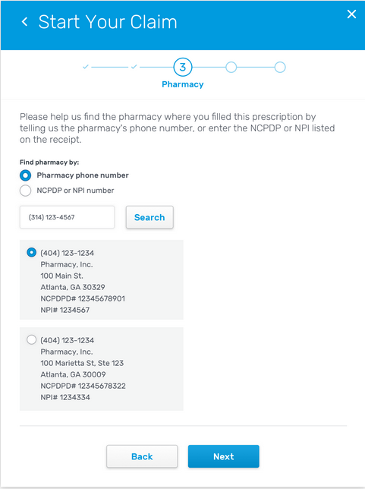
Retail Pharmacy
For Single ingredient or Compound drugs, member enters NCPDP or NPI number from their receipt
OR
If COVID-19 Test kit was purchased in a pharmacy retail store, please input phone number to help locate pharmacy information
If COVID-19 Test kit was purchased at a non-pharmacy retailer, input 3000003

Slide 10
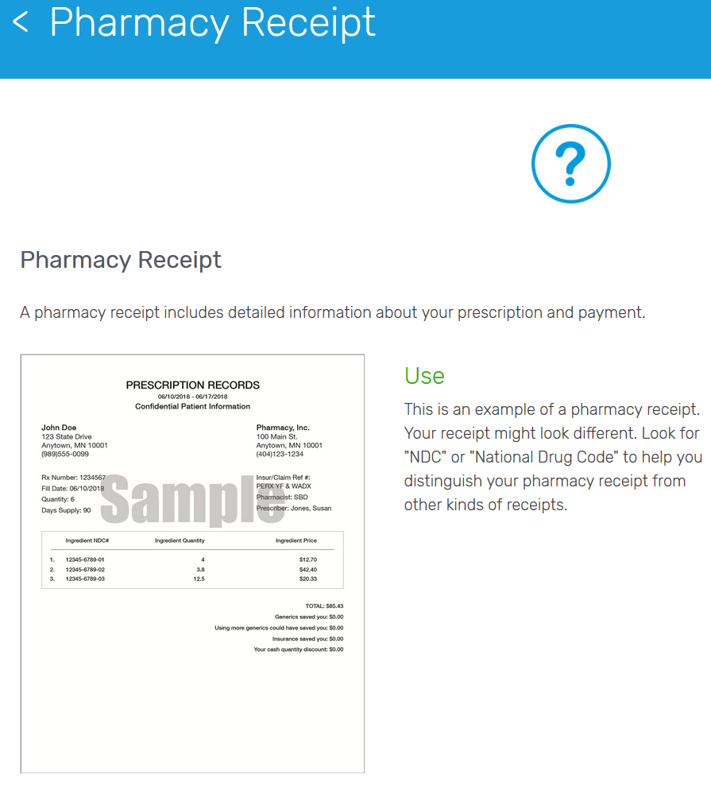
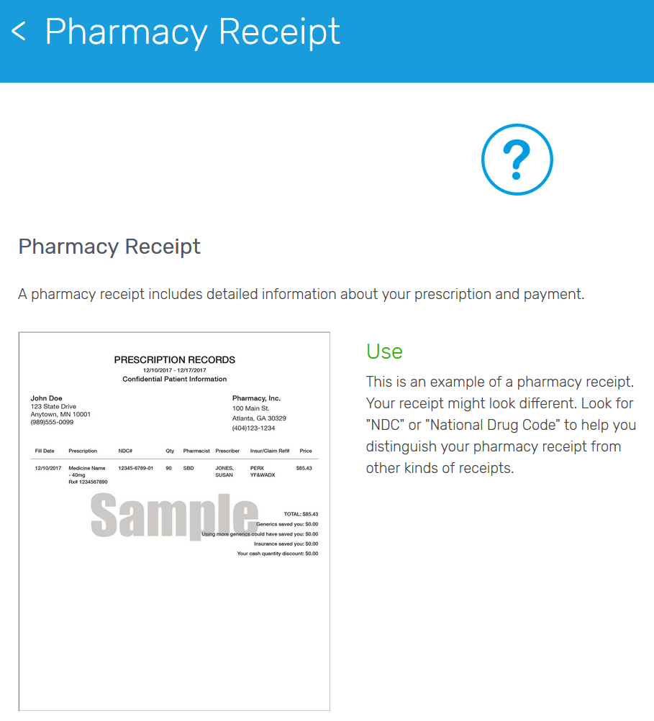
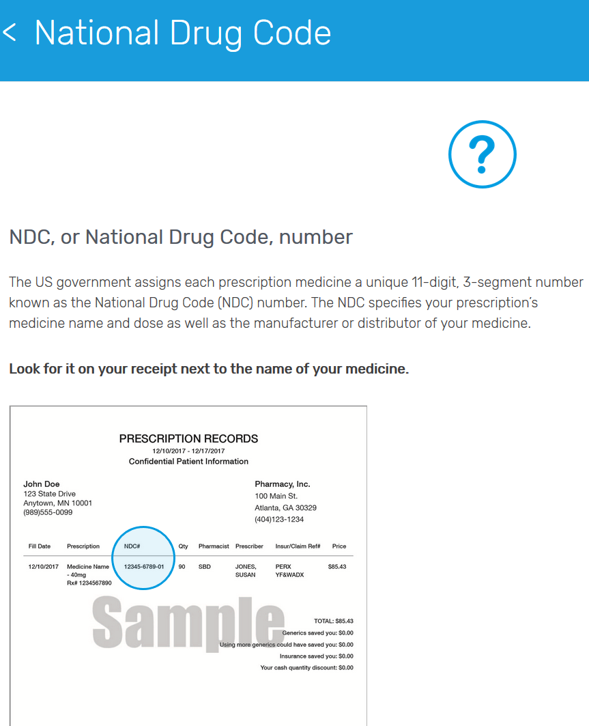
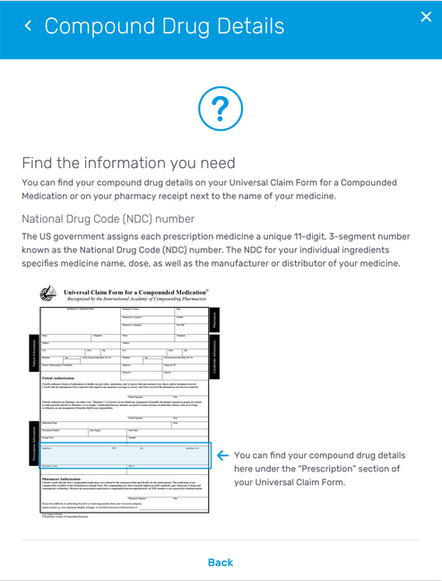
Contextual Help
Members are given contextual help throughout the process, showing them where different fields can be found on a typical pharmacy receipt.
This will help in reducing member abandonment and confusion.

Slide 11
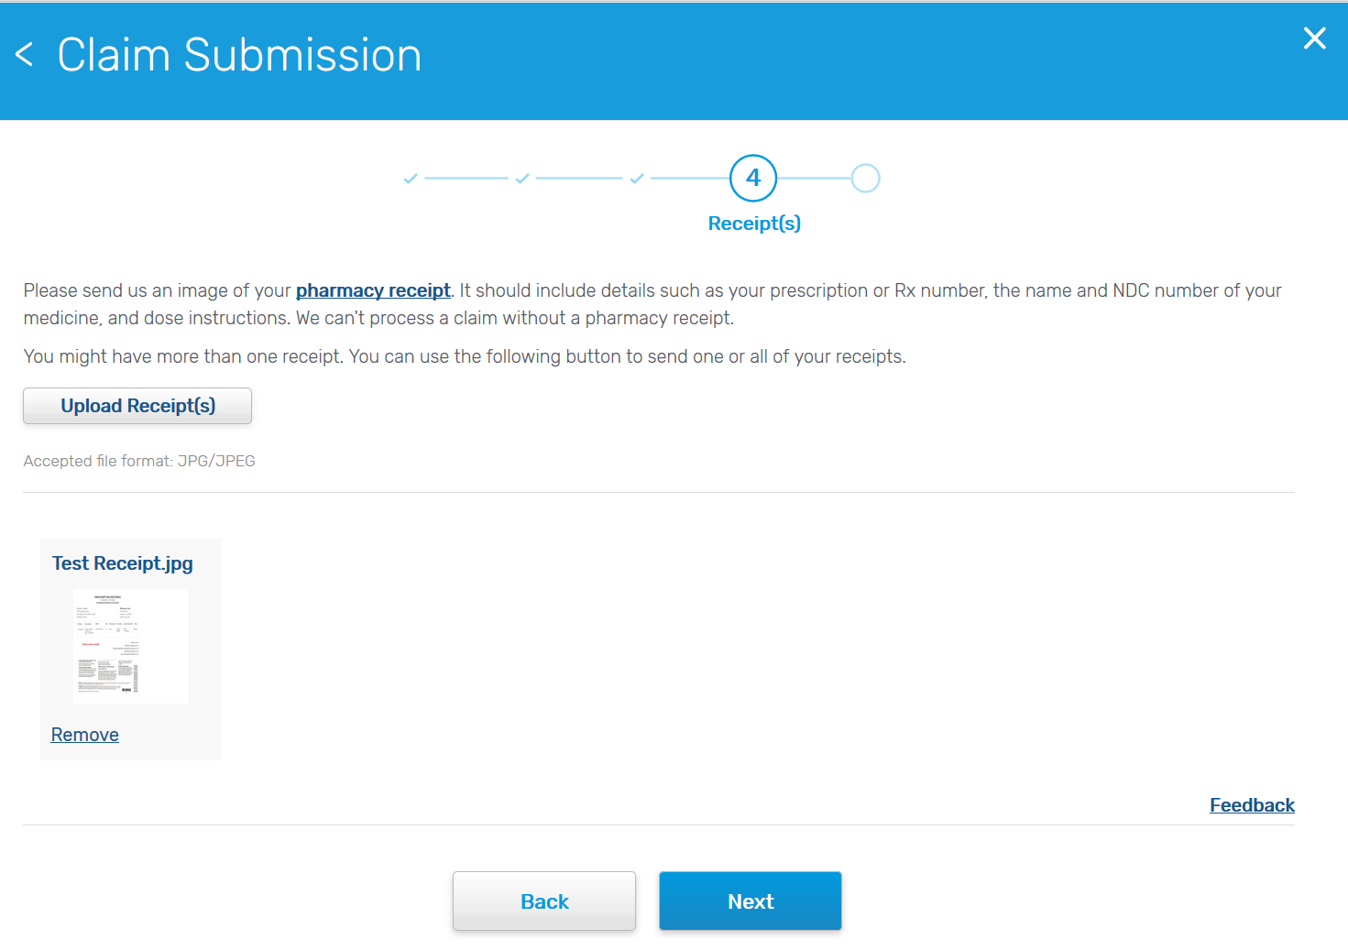
Receipt Upload
The member must upload at least one receipt to attach to the claim.
Please note: Currently, members are only able to upload JPG/JPEG files. We will be extending this to additional files in the future.

Slide 12
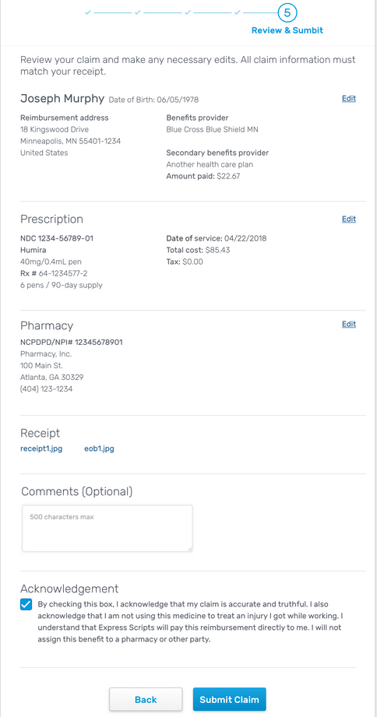
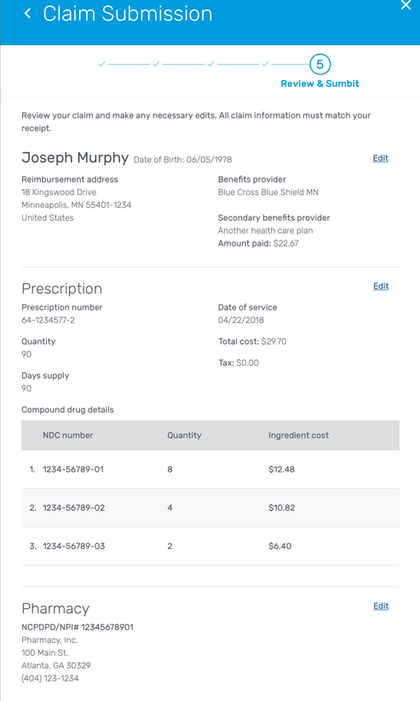
Review & Submit
Single Ingredient view
Member has the opportunity to make edits, view the receipt they’ve uploaded and submit their claim.
The member must agree to the legal terms before they can submit the claim.

Slide 13
Close Prompt
If the member chooses the close button at any point, the member will receive this message asking them if they wish to close out of the application.

Slide 14
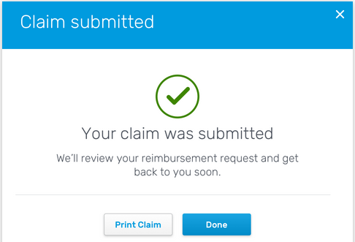
Confirmation
Member can print the claim information that they submitted, if desired.
Once member clicks Done, the application closes and the member is returned to the member website page they started from.

Slide 15
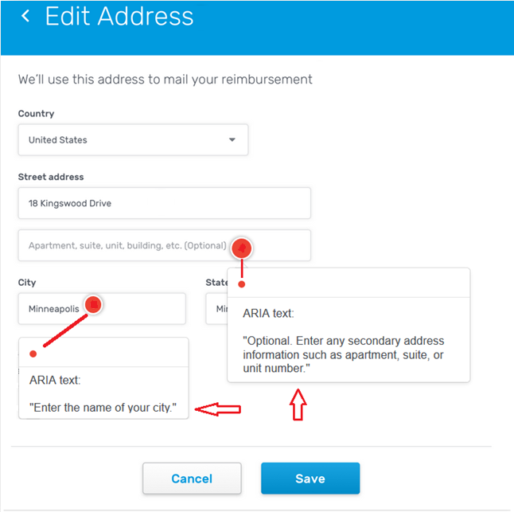
Accessibility
DCSS tool is now available to users with disabilities, people who rely on screen readers and people who cannot use a mouse.
WAI-ARIA (Web Accessibility Initiative – Accessible Rich Internet Applications) technique defines a way to make Web content and Web applications more accessible to people with disabilities.
When user navigates trough the fields on the screen, custom messages are read to the user.

Slide 16
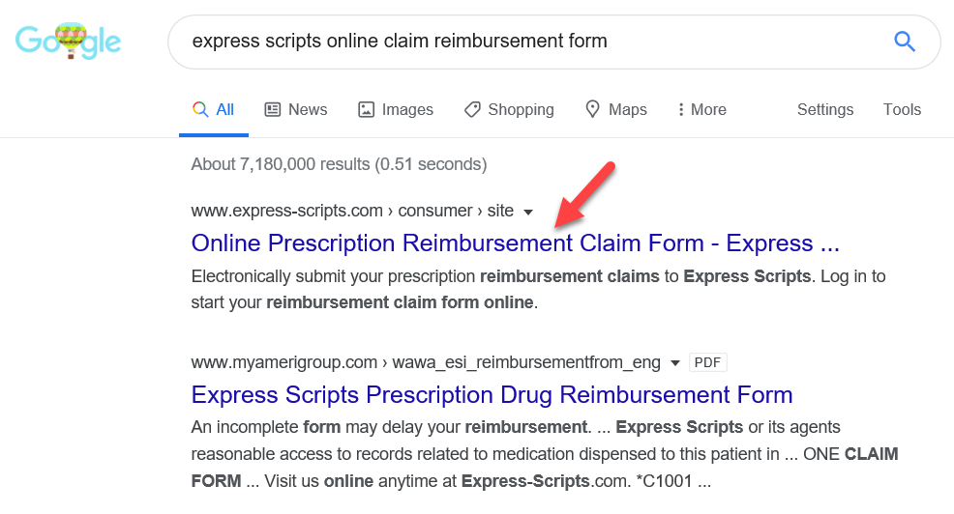
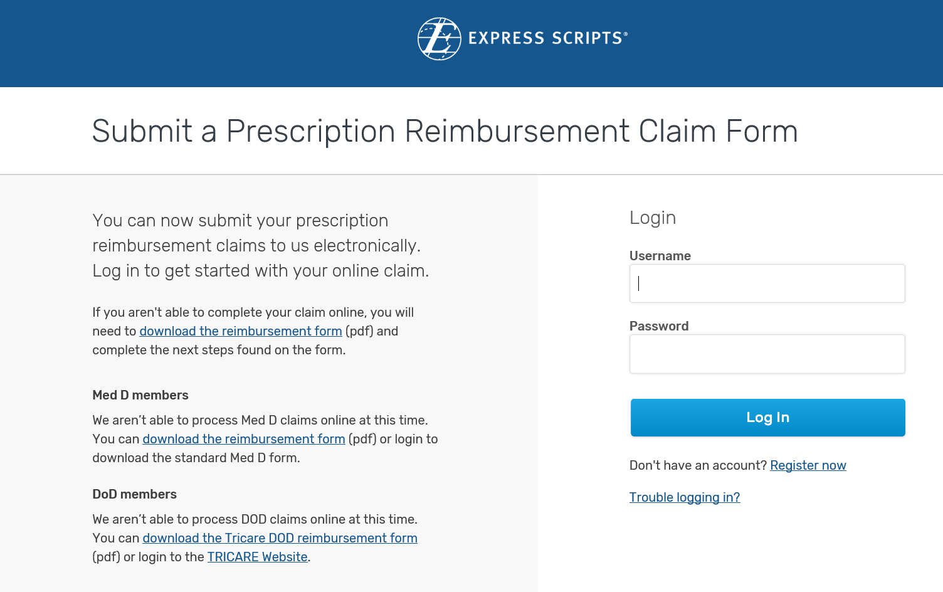
Landing page
Prescription Reimbursement Claim Form Landing page were created to enhance search engine results to help drive the member experience through the improved ability to find and download an Express Scripts claim form.
Landing page also provides users with a shortcut to the DCSS tool for electronic claim submission.

