Slide 1

2019 ABCC OUTREACH
Ralph Sacramone Ryan Melville
Executive Director Licensing Supervisor
617-727-3040 ext. 731 617-727-3040 ext. 718
rsacramone@tre.state.ma.us rmelville@tre.state.ma.us

Slide 2
We Have a New Address
ABCC ADDRESS CHANGE
Alcoholic Beverages Control Commission
95 Fourth Street, Suite 3
Chelsea, MA 02150
All applications and correspondence should be mailed to the address above.

Slide 3
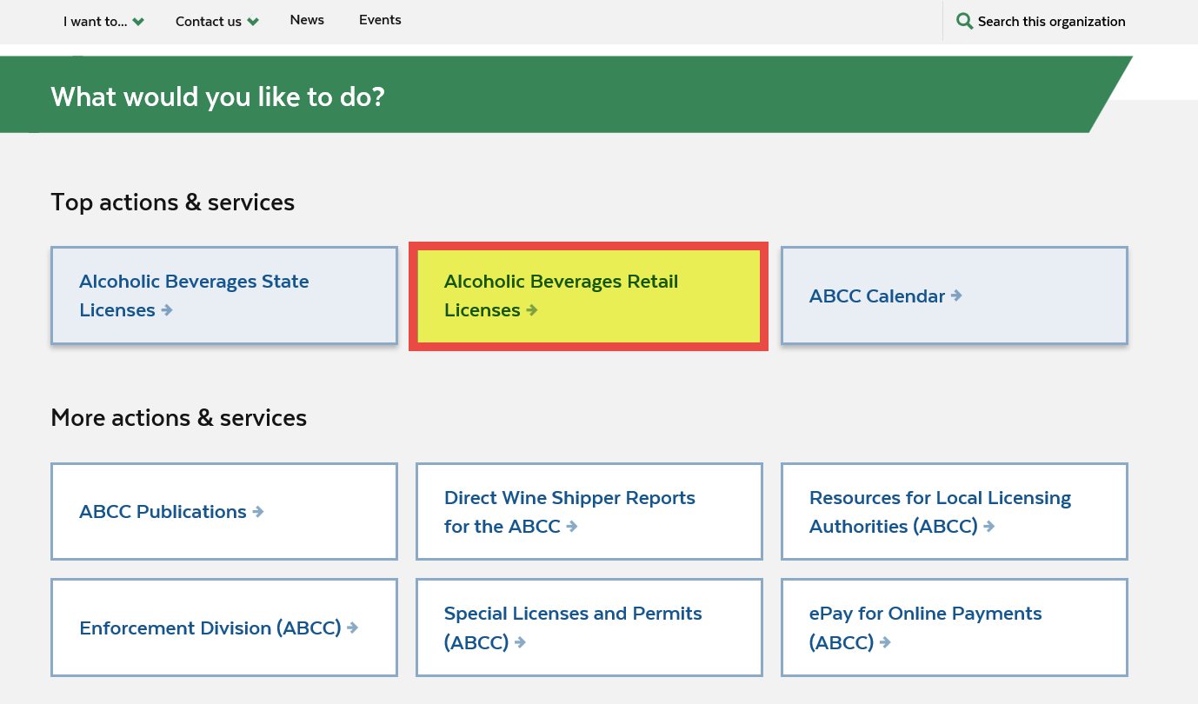
RETAIL LICENSES
Notes:
ABCC home page

Slide 4
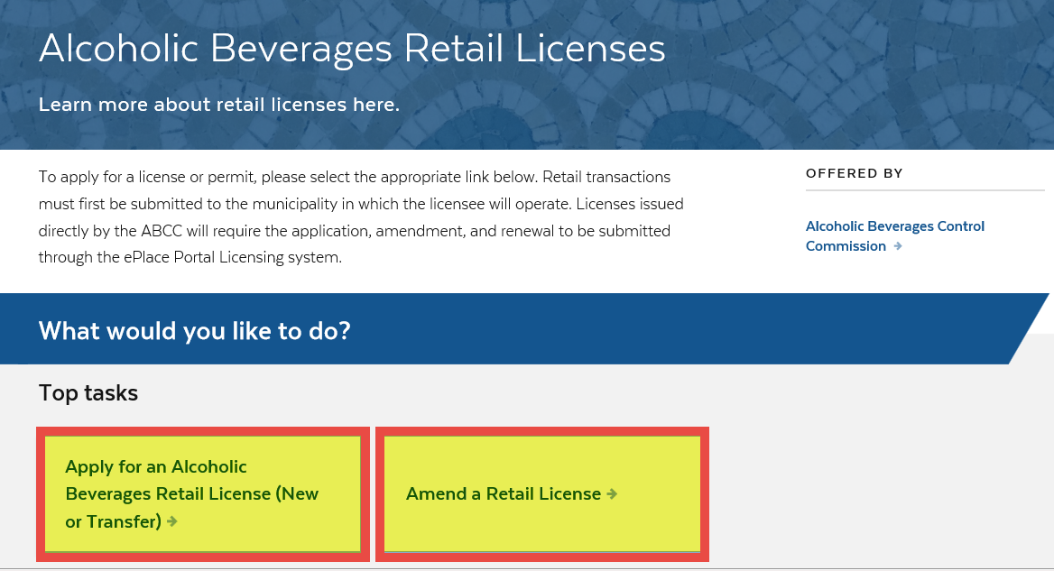
Change to an existing license
APPLICATION vs AMENDMENT
New license or transfer of existing license
Change to an existing license
Notes:
Retail license

Slide 5
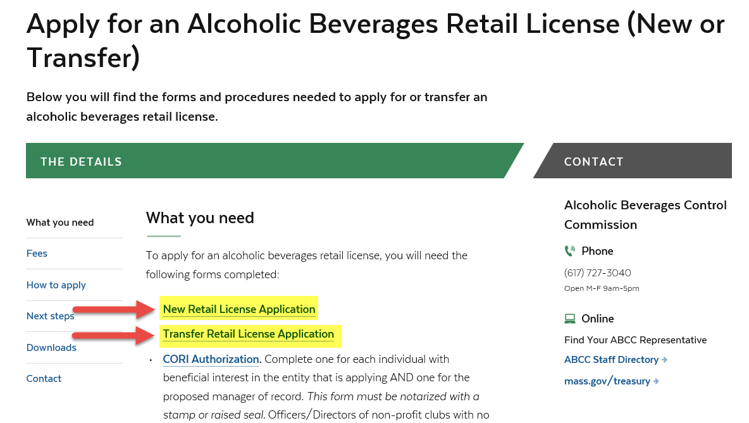
2014 RETAIL RENEWALS
NEW vs TRANSFER
Notes:
New retail license – what you need

Slide 6
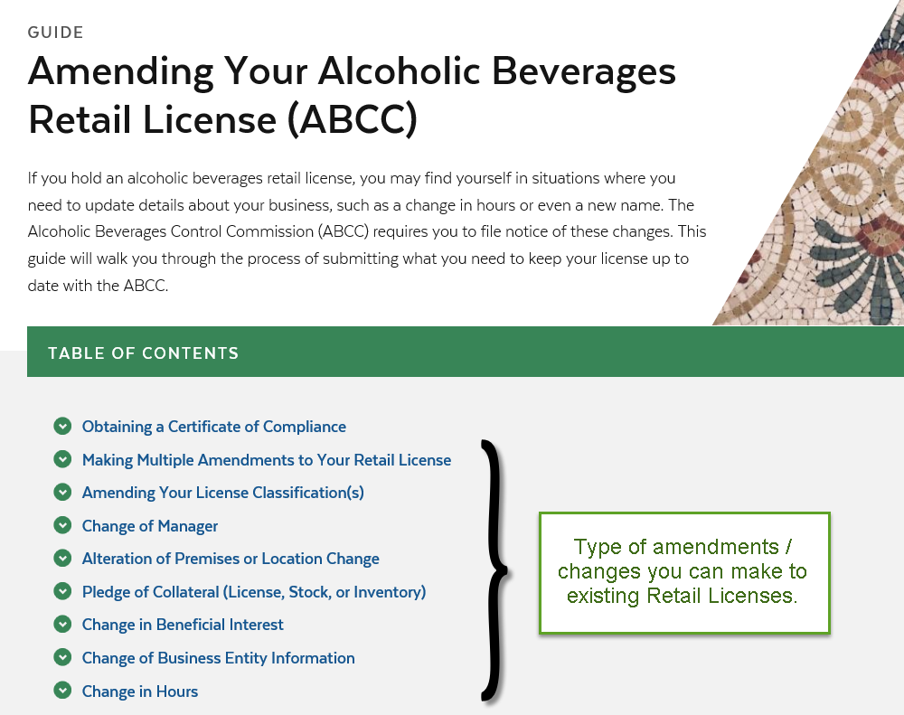
AMENDMENT TYPES

Slide 7
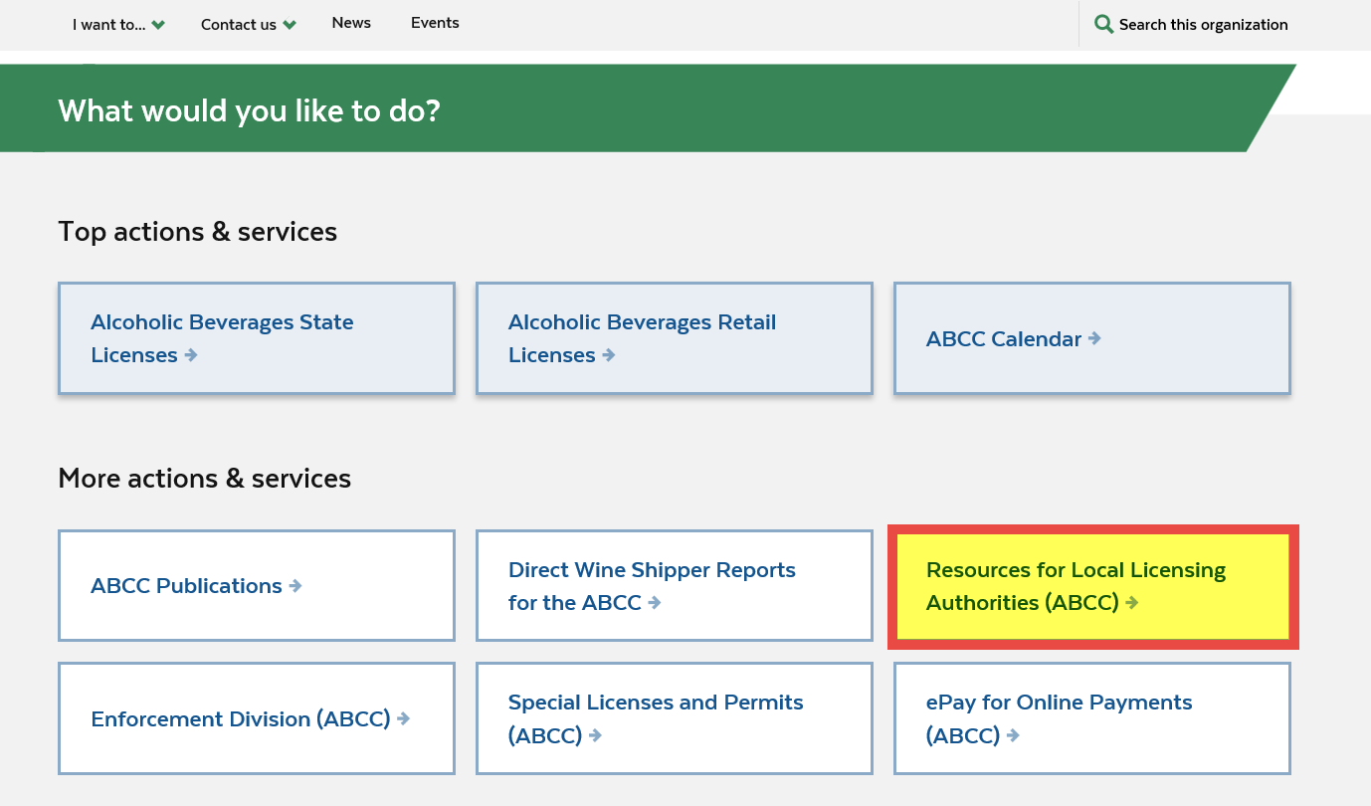
RESOURCES / FORMS FOR LLAs
Notes:
ABCC home page

Slide 8
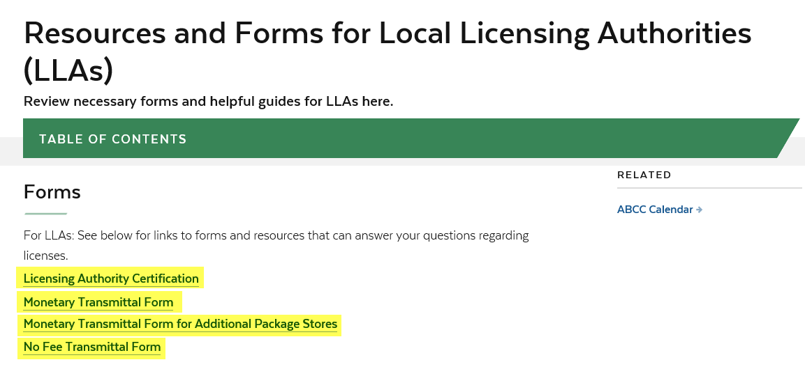
RESOURCES / FORMS FOR LLAs

Slide 9
Notes:
NEW “Form 43” a/k/a Licensing Authority Certification - with changes / new wording highlighted

Slide 10
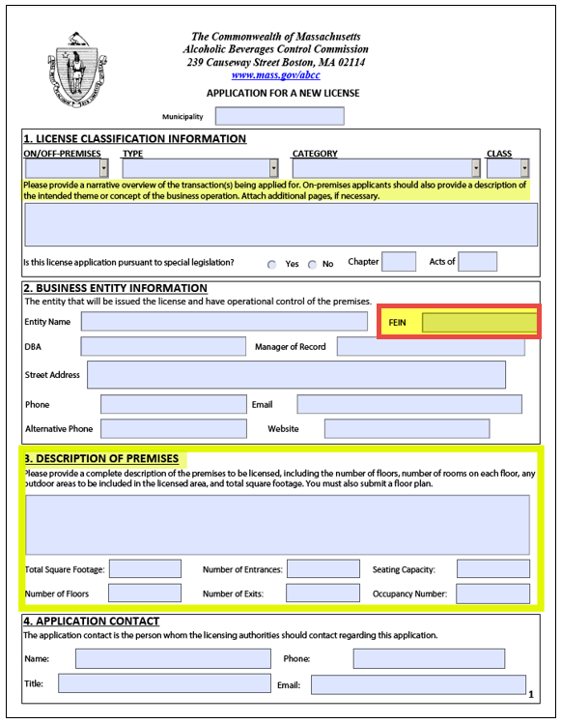
Notes:
New license application, pg. 1

Slide 11
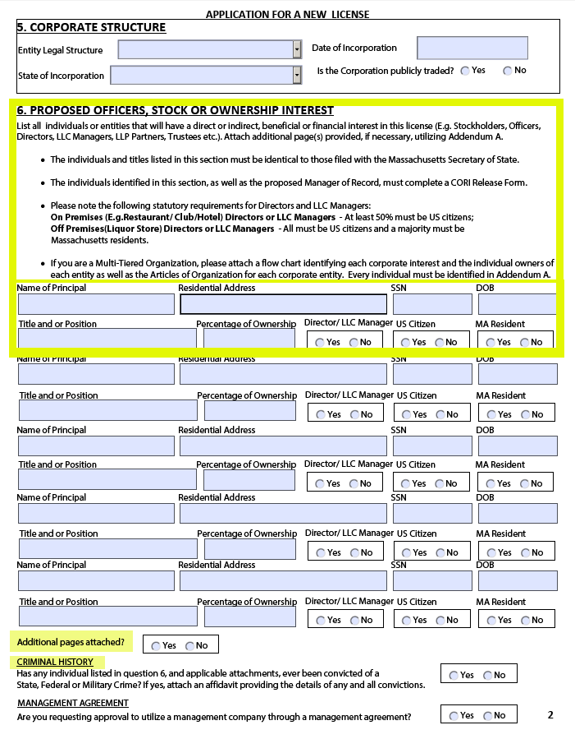
Notes:
New license application, pg. 2

Slide 12
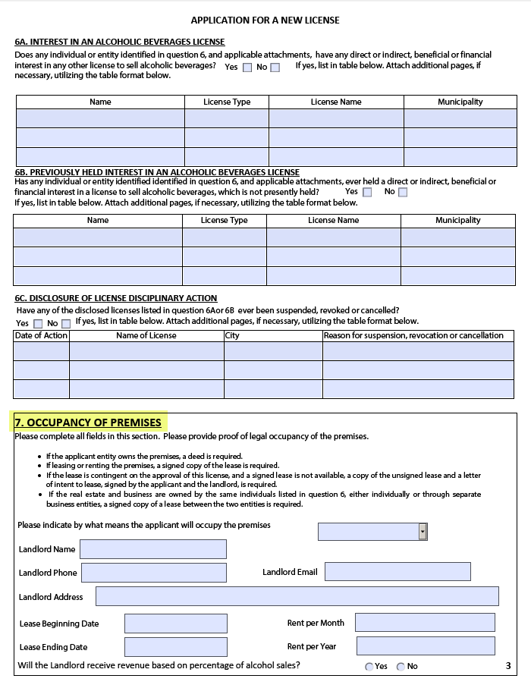
Notes:
New license application, pg. 3

Slide 13
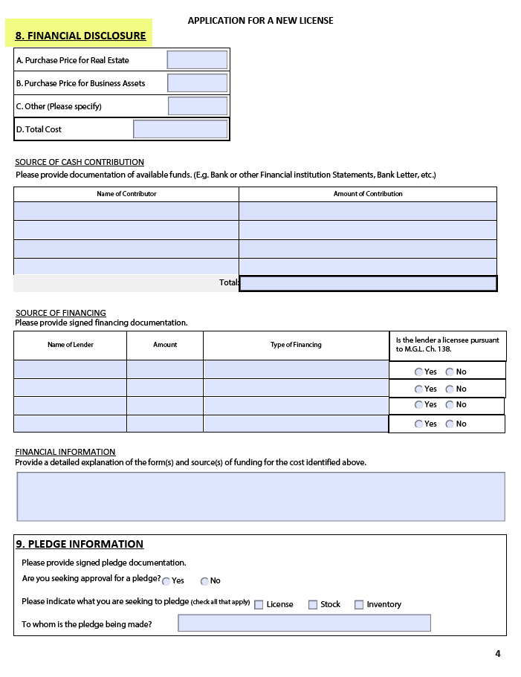
Notes:
New license application, pg. 4

Slide 14
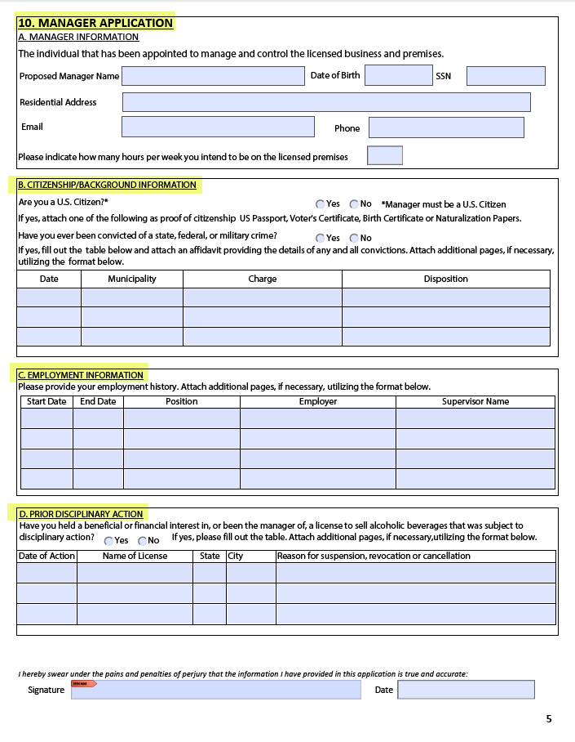
Notes:
New license application, pg. 5

Slide 15
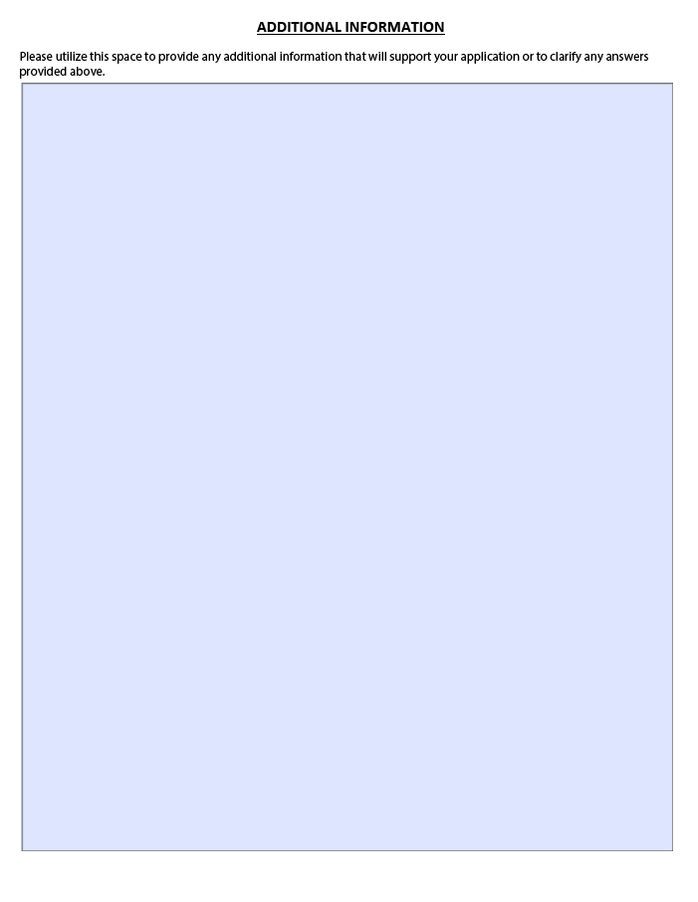
Notes:
New license application, pg. 6

Slide 16
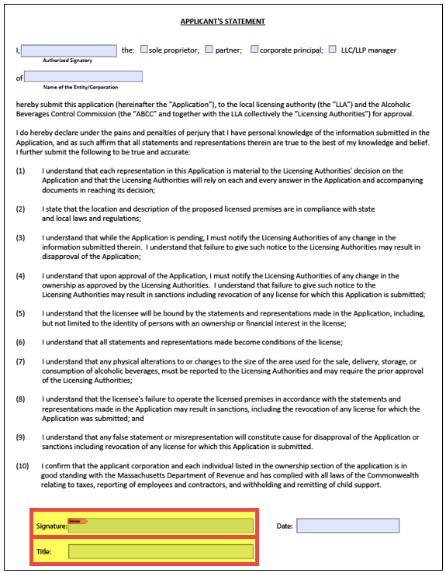
Notes:
New license application, pg. 7

Slide 17
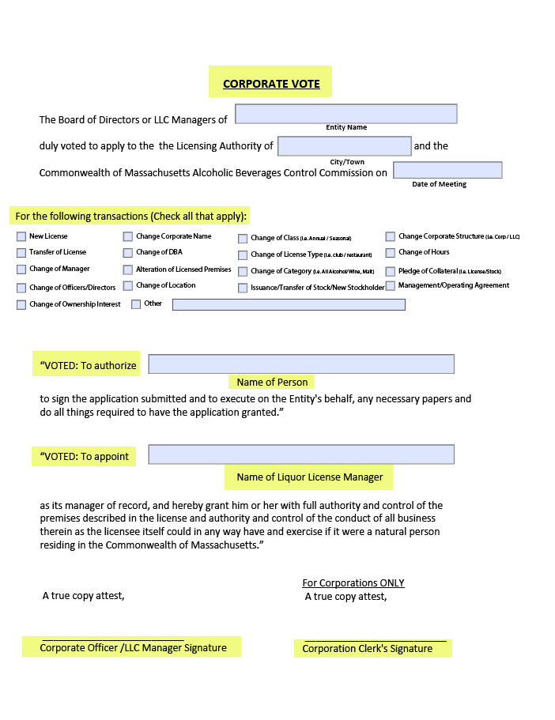
Notes:
New license application, pg. 8

Slide 18
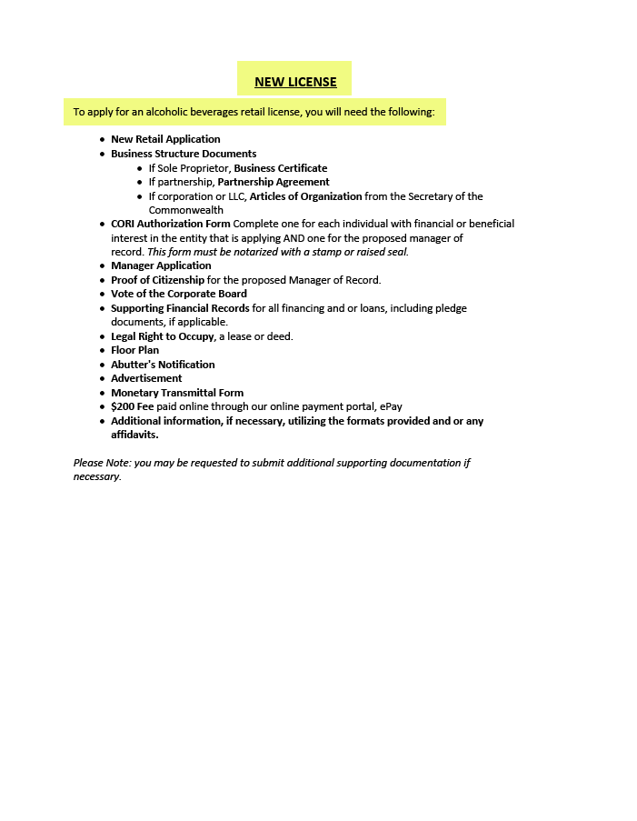
Checklist
Notes:
New license application, pg. 9

Slide 19
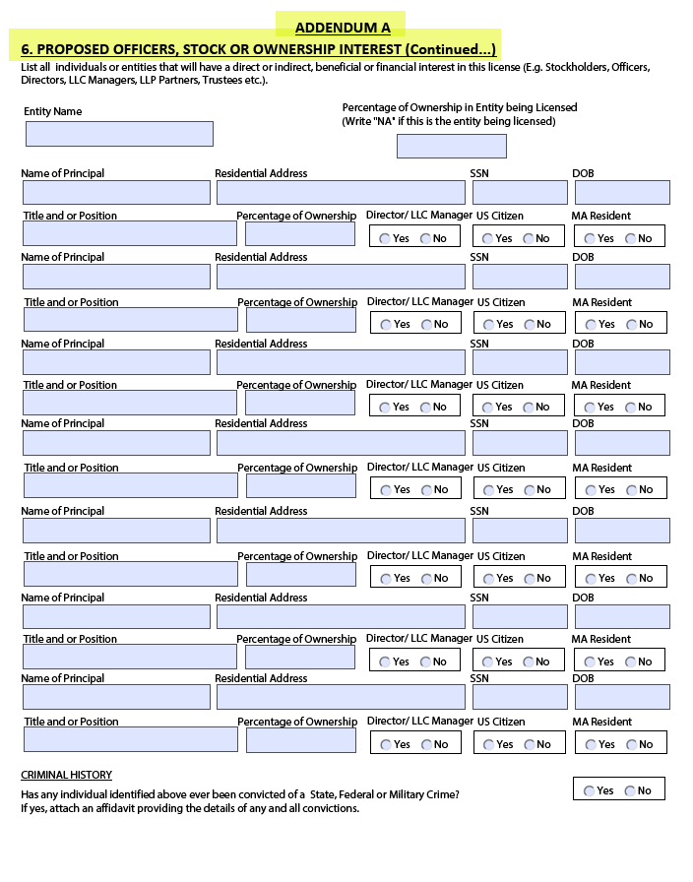
Notes:
New license application, pg. 10

Slide 20
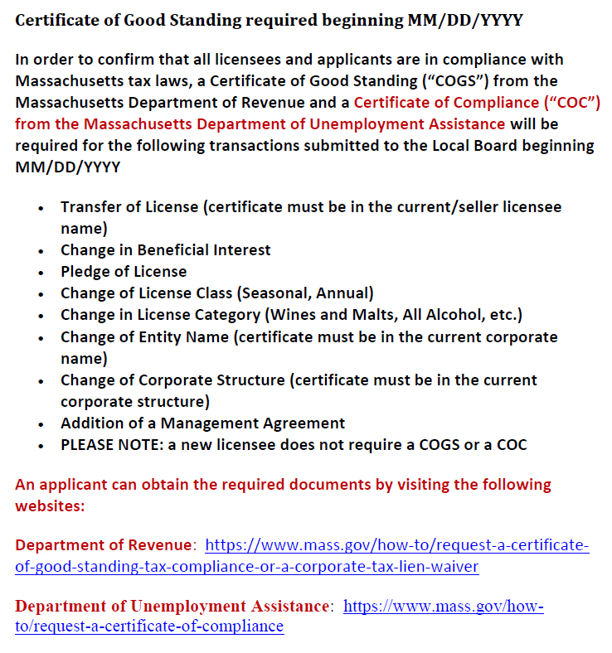
CERTIFICATE OF COMPLIANCE
Notes:
DUA – Certificate of Compliance

Slide 21
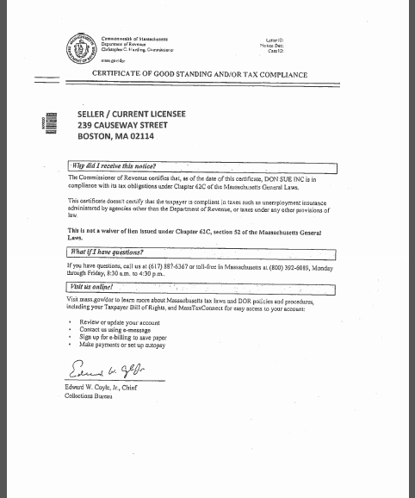
DOR CERTIFICATE OF COMPLIANCE
Please ensure the DOR Certificate of Good Standing is from the current licensee.

Slide 22
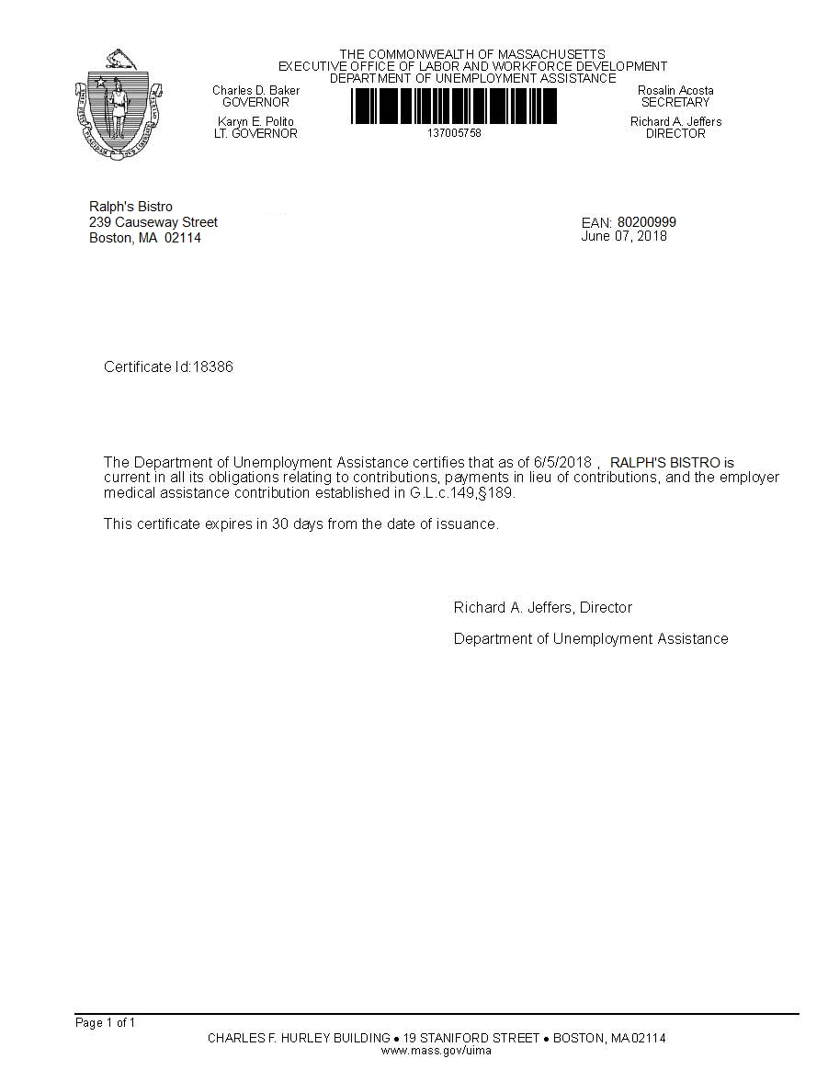
DUA CERTIFICATE OF COMPLIANCE
Notes:
DUA – (Dummy) Certificate of Compliance letter

Slide 23
DUA CONDITIONAL RELEASE
Notes:
DUA – Dummy Conditional Release letter

Slide 24
APPLICATIONS & AMENDMENTS RETURN NO ACTION
The ABCC will work diligently to process applications completely when they are received.
In some cases however additional local board action or substantial information is missing from an application or amendment.
In those cases the ABCC will return the transaction “Returned No Action” or RNA and include a recommendation from an investigator on what is missing or required.
The local board should inform the applicant what is missing along with the remarks from the investigator.
The applicant should then provide the information to the local board and based on the approval of the local board the LLA Certification and missing information should be resent to the ABCC with the reconsideration box checked on the LLA Certification form.

Slide 25
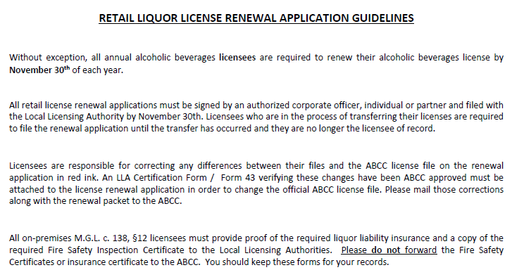
RETAIL RENEWALS

Slide 26
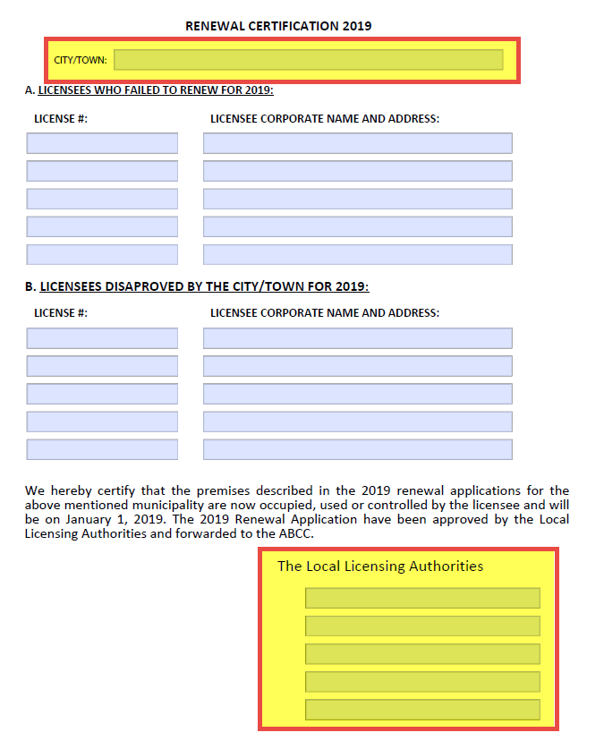
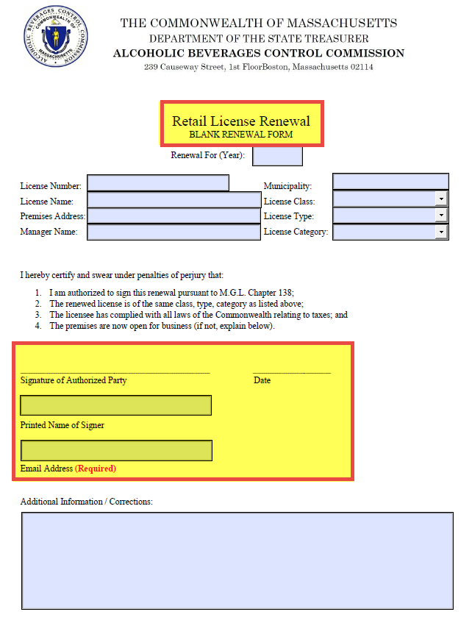
RETAIL RENEWAL FORMS

Slide 27
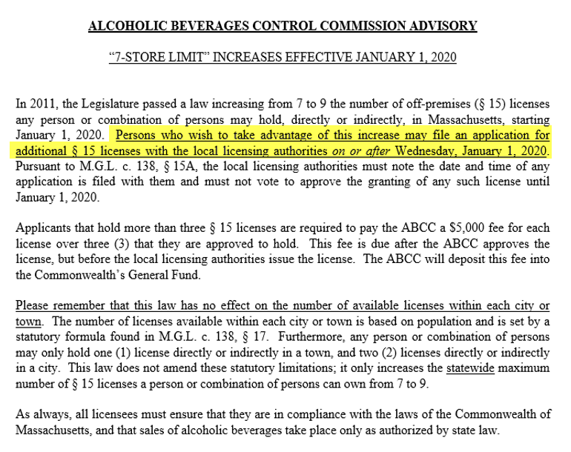
ADDITIONAL PACKAGES STORES

Slide 28
Thank you for your time

