Slide 1
Massachusetts Department of Housing and Community Development Community Development Block Grant Program
Charles D. Baker, Governor
Karyn E. Polito, Lt. Governor
Jennifer Maddox, Undersecretary

Slide 2
AGENDA
HUD Opening Remarks – Bob Shumeyko, New England CPD Regional Director
CDBG Awards 2021
Contracts
Grant Management – clearance documents
Single Case Waivers – pre and post 2021
Section 3 updates
Questions Received via Email
2022 One Year Plan Changes – highlights
DHCD web page https://www.mass.gov/service-details/community-development-block-grant-cdbg

Slide 3
2021 CDBG Grant Start-Up for:
Community Development Fund
$29,596,870 awarded
34 grants
56 communities
Mini-Entitlements
$9,074,710
11 grants

Slide 4
Contracts
Contract Documents
Cover letter – Email
Commonwealth Standard Contract Form
We are accepting e signature (via Adobe sign) on the Standard Contract Form. Please use your mouse when you electronically write your signature.
Please complete the following documents and sign with a wet signature (print and sign with a pen). Please email directly to julissa.tavarez@mass.gov or daishawn.riddick@mass.gov.
Authorized Signatory Listing Form
Proof of authentication of Signature
Exhibit A
Settlement & Release (if needed)
Attachment A – Scope of Services
Budget

Slide 5
Contracts and Start-Up Procedures
In order to carry out grant activities: Award Letter
A fully executed contract
Special Conditions clearance, if applicable
Professional Services agreement, if applicable – Model Contracts available
Environmental Release of Funds
City/Town may incur pre-agreement costs for administrative and other start-up costs not subject to 24 CFR Part 58, Environmental Review, as of January 1, 2022.

Slide 6
Contract Cover Page

Slide 7
Signature Verification Forms

Slide 8
Settlement & Release Form
1.1.22

Slide 9
Grant Contract: Attachment A – Scope of Services
Specifies Responsibilities of Grantees
City/Town responsible
Incorporates the RFP
Establishes the framework of program implementation
Specifies the implementation period of the grant
1/1/2022 – 6/30/2023

Slide 10
Attachment A – Additional Terms & Conditions – Compliance Requirements
Title I of the 1974 HCDA
HUD regulations 24 CFR Part 570
2 CFR 200 – Uniform Administrative Requirements, COST PRINCIPLES, AND AUDIT REQUIREMENTS FOR FEDERAL AWARDS, as applicable
Other federal laws & regulations – Davis Bacon, Section 3,NEPA, Lead Paint, DOL Regs, Arch Barriers Act, the Americans with Disabilities Act…

Slide 11
Attachment A Mass. CDBG Program Requirements
Activities and Management Plan as submitted in Application - Changes to either require DHCD approval
Additional Special Conditions - requires DHCD clearance
Standard HR and Civil Rights; Project Descriptions; Budget explanations
Relocation Plans; Anti-Speculation; Public Hearing info
Mass CDBG Program Management Manual
Photographic documentation for construction -
Contractor shall erect a temporary sign and, if applicable, permanent signs, which acknowledge the funding source as follows: The U.S. Department of Housing and Urban Development and the Department of Housing and Community Development, Massachusetts CDBG Program.

Slide 12
Grant Management
Contractor will implement funded activities in accordance with the management plan
Any substantive change in the management plan requires prior written approval by the Department
The Department reserves the right to review personnel hiring decisions

Slide 13
Attachment A Reporting Requirements
QPRs, Audits, Section 3, Labor Standards
Real property owned or controlled by units of local governments and improved with CDBG funds, may not have its use changed for a period of five years after the closeout of the grant that assisted the property unless the change of use is consistent with 24 CFR 570.489(j). Further, grantees will certify to DHCD on an annual basis that they are maintaining the original use of the building.

Slide 14
Mass CDBG Operations Manual
Referenced in Attachment A and monitoring report
Designed to assist with Program Implementation and Reference Guide
Technical Assistance
Dated, but still contains valuable information related to successful grant implementation
Updated Chapters posted on webpage
TA memos on webpage – HR, PSS, ABR, Infrastructure
Boilerplate Contracts

Slide 15
Clearance Docs. – A Few Reminders
ER – MHC Notification & Checklist Documentation
ER - 58.6 Form for Exempt Activities
PSC – Method and Schedule of Compensation
Special Conditions – notes from Program Rep.
Special Conditions – don’t resubmit application docs.

Slide 16
Single Case Waivers prior to FY 2021
Effective 4/1/22
Project does not include lead, barrier removal, septic, asbestos, or historic preservation and is $35-$40k
Project includes lead, barrier removal, septic, asbestos, or historic preservation and is $40-$50k
Only SCW form must be submitted for approval, reserve the right to ask for back-up on a case-by-case basis
Project does not include lead, barrier removal, septic, asbestos, or historic preservation and is >$40k
Project includes lead, barrier removal, septic, asbestos, or historic preservation and is >$50k
Submit Initial Inspection, WWU, Cost Est, bid summary, change order, lead report, photo documentation

Slide 17
Section 3 updates…

Slide 18
Emailed Questions/Comments
Documenting Attendance at Virtual Hearing
Attachment B “Method and Compensation Schedule” – connecting to milestones/activities
Uniformity of Special Conditions
Statutory Checklist with signature block
Hiring of engineers for horizonal construction projects – exempt from procurement?
Davis-Bacon Employee Interviews for shorter time-frame
Deadline of end-of-fiscal year drawdown (July 15th)
Effective date of PSC / Settlement & Release

Slide 19
Emailed Questions/Comments Continued…
FFY21 grant contracts 4 state fiscal years – how much held in each year?
Extended Single Audit Act deadline?
Single Audit - $750,000 in expenses, not receipts?
GMS Training Module – Direct Depository and Program Income Accounts?
Copies of PowerPoint presentations
Timeline for next Application

Slide 20
CDBG One-Year Action Plan-FFY2022 Changes
Delay the issuance of 2022 funds and combine with 2023 funds, with application due March 2023
Revision of timely expenditure requirement to coincide with the time change
Increase the amount a single community may request from $800,000 to $1,350,000
Increase the amount a regional application may request $1,200,000 to $1,500,000
Increase the program implantation period from 18 months to 24 months
Community Development Strategy requirement for Mini-Entitlements
Program Amendment limited if haven’t started grant

Slide 21
DHCD WEBPAGE Resources - https://www.mass.gov/service-details/community-development-block-grant-cdbg
“QRs, Extensions, Amendments” – the basics
GMS Guidance
Performance Measures/Lead Paint Reporting
SCW procedure
Close-Out
Procurement Guidance & Charts
Housing Rehab TA Memo Handout
Environmental Review forms

Slide 22
Program Representatives FFY 2021
Nate Delude – Brookfield, Dudley, Chesterfield, Easthampton, Fairhaven, Millbury, North Brookfield, Orange, Southbridge, Warren, Webster
Golnaz Tabatabai – Amherst, Athol, Methuen, Montague, Palmer, Shelburne, Southwick, West Springfield
Anna Whitten – Adams, Chelsea, Edgartown, Greenfield, North Adams, Oak Bluffs, Salisbury, Truro, Ware
Kathryn McNelis – Gardner
Shelly Chevalier – Egremont, Everett, Huntington, Leicester, Spencer, Wareham
Bryan Wyatt – Amesbury, Bellingham, Chester
Charles Sanderson – Brewster, Clinton, Erving, Hadley, Holbrook, Monson, Randolph
Contact: firstname.lastname@mass.gov

Slide 23
Fiscal Representatives for FFY 2021 Grants
Don Martin – Adams, Brewster, Brookfield, Chelsea, Clinton, Egremont, Erving, Fairhaven, Gardner, Holbrook, Huntington, Leicester, Millbury, Monson, North Brookfield, Orange, Shelburne, Southbridge, Southwick, Truro, Ware, Wareham, Warren, Webster
Emily McLaughlin – Amesbury, Amherst, Athol, Bellingham, Chester, Chesterfield, Dudley, Easthampton, Edgartown, Everett, Greenfield, Hadley, Methuen, Montague, North Adams, Oak Bluffs, Palmer, Randolph, Salisbury, Spencer, West Springfield
Contact: firstname.lastname@mass.gov

Slide 24
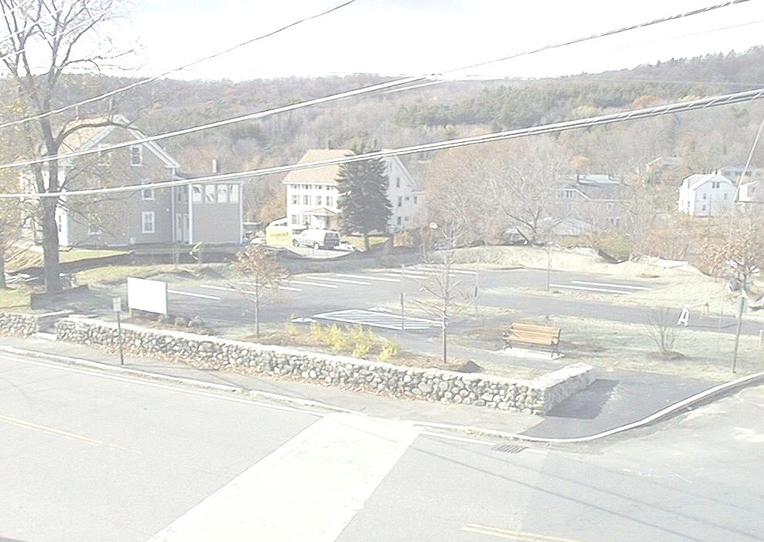
Charles Baker, Governor
Karyn Polito, Lt. Governor
Jennifer Maddox, Undersecretary
DHCD
100 Cambridge Street, Suite 300
Boston, MA 02114
Phone: 617.573.1400
Fax: 617.573.1460
www.mass.gov/dhcd/

